Slide 1

Objectives
In this session, you will learn to:
  Understand and create Inventory Vouchers
Notes:
Share the session objectives with the students.

Slide 2
Understanding Inventory Vouchers
Tally.ERP 9 Inventory Vouchers:
  Perform the same function in the inventory system as accounting vouchers do in the accounting system.
  Are used to enter transactions relating to the Inventory.
  Record transactions relating to:
    Issue and receipt of stock
    Transfer of stock between godowns
    Physical stock adjustments

Slide 3
Understanding Inventory Vouchers (Contd.)
Following types of inventory vouchers are available in Tally.ERP 9:
  Purchase Order (Alt+F4)
  Sales Order (Alt+F5)
  Rejections Out (Alt+F6)
  Rejections In (Ctrl+ F6)
  Stock Journal (Alt+F7)
  Delivery Note (Alt+F8)
  Receipt Note (Alt+F9)
  Physical Stock (Alt+F10)

Slide 4
Understanding Inventory Vouchers (Contd.)
Purchase order:
  A purchase order entry is made in the books of the company in order to check whether the goods have been received or not.
  In order to do the same, the purchase order number can be used as a reference.

Slide 5

Understanding Inventory Vouchers (Contd.)
When can a purchase order be used?

Slide 6

Understanding Inventory Vouchers (Contd.)
A purchase order can be used when a company wishes to place an order with the supplier for some goods, as shown in the following figure.

Slide 7
Understanding Inventory Vouchers (Contd.)
What is recorded in a sales order?

Slide 8

Understanding Inventory Vouchers (Contd.)
Sales order:
  Records data of an order that a customer places with the company for purchasing some goods, as shown in the following figure.

Slide 9

Understanding Inventory Vouchers (Contd.)
Rejections out:
  A rejections out entry is passed to record the rejected goods.
  It is a pure inventory voucher.
  The following figure shows a sample entry of a rejections out.

Slide 10

Understanding Inventory Vouchers (Contd.)
Rejections in:
  A rejections in entry is passed to record the rejected goods.
  The rejections in entry is a pure inventory voucher.
  The following figure shows the sample entry of a rejections in when a customer has rejected goods that were sold earlier.

Slide 11
Understanding Inventory Vouchers (Contd.)
Stock journal:
  To avoid the entry of the consumption of goods on both sides of the voucher, stock journal is used.

Slide 12
Understanding Inventory Vouchers (Contd.)
When is a stock journal used?

Slide 13

Understanding Inventory Vouchers (Contd.)
Stock journal:
  The following figure shows the sample entry of a stock journal used when a company transfers items of stock from the warehouse to the shop.

Slide 14
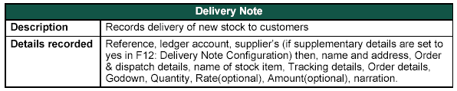
Understanding Inventory Vouchers (Contd.)
Delivery note:
  Records goods that are being delivered to a customer.
  The following figure shows the sample entry of a delivery note.

Slide 15
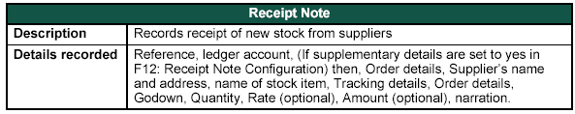
Understanding Inventory Vouchers (Contd.)
Receipt note:
  Records goods that are received from the supplier.
  The following figure shows the sample entry of a receipt note.

Slide 16
Understanding Inventory Vouchers (Contd.)
Physical stock voucher:
  Records the stock available in the company and Tally.ERP 9 considers only this entry.

Slide 17
Understanding Inventory Vouchers (Contd.)
When is a physical stock voucher used?

Slide 18

Understanding Inventory Vouchers (Contd.)
Physical stock voucher:
  It is used in case a company finds a discrepancy between the actual stock and the recorded stock figure on conducting a stock check.
  The following figure shows the sample entry of a physical stock voucher.

Slide 19
Understanding Inventory Vouchers (Contd.)
Pure inventory transactions:
  Pure inventory transactions (vouchers) do not affect financial records. They affect only the stocks.
  Following types of pure inventory vouchers are present in Tally.ERP 9:
    Rejections Out (Alt+F6)
    Rejections In (Ctrl+F6)
    Stock Journal (Alt+F7)
    Delivery Note (Alt+F8)
    Receipt Note (Alt+F9)
    Physical Stock (Alt+F10)

Slide 20

Understanding Inventory Vouchers (Contd.)
Let us see how to enable Delivery Note and Receipt Note in Tally.ERP 9.
Notes:
You need to perform the steps given under the following topic:
5.2.9 Pure Inventory Transactions (page 112)

Slide 21
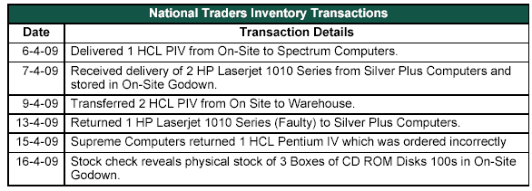
Understanding Inventory Vouchers (Contd.)
Recording inventory transactions:
  The following figure lists the inventory transactions of National Traders for April 2009.

Slide 22
Understanding Inventory Vouchers (Contd.)
The following steps are followed to enter the inventory vouchers:
  Go to the Gateway of Tally > Inventory Vouchers.
  Change the date, if necessary.
  Select the voucher type from the button bar menu.
  Type the details and check whether they are correct before accepting.
  Accept the default rates of items that appear according to the standard cost and standard selling price given in the workbook.

Slide 23
Understanding Inventory Vouchers (Contd.)
Let us see how to create stock summary for April 2009.
Notes:
You need to perform the steps given under the following topic:
5.2.11 Stock Summary for April 2009 (page 116)

Slide 24
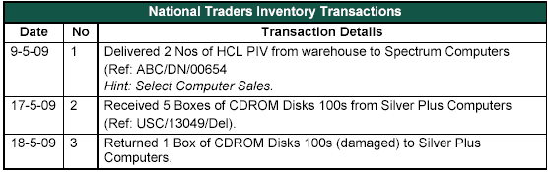
Understanding Inventory Vouchers (Contd.)
Recording inventory transactions:
  The following figures list the inventory transactions of National Traders for the months of May and June 2009.

Slide 25
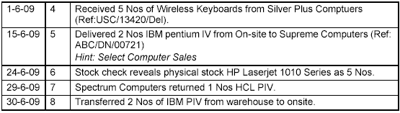
Understanding Inventory Vouchers (Contd.)

Slide 26
Understanding Inventory Vouchers (Contd.)
Let us see how to create stock summary for June 2009.
Notes:
You need to perform the steps given under the following topic:
5.2.12 Stock Summary for June 2009 (page 118)

Slide 27
Understanding Inventory Vouchers (Contd.)
Entering Inventory Details in Accounting Vouchers:
  It is useful for organisations that send and receive goods with a bill or invoice only.
  Sales and purchase vouchers record the inventory movements and the following vouchers are used to record the stock movements:
    Debit note for goods rejected and returned to supplier
    Credit note for goods rejected and returned by customer
  In addition, debit and credit notes are used to record the return of goods and the corresponding reversal of sales and purchases.

Slide 28

Understanding Inventory Vouchers (Contd.)
The following figure shows a purchase voucher when a company receives a new stock from a supplier.

Slide 29

Understanding Inventory Vouchers (Contd.)
The following figure shows a sales voucher when a company delivers goods from its stock to a customer.

Slide 30

Understanding Inventory Vouchers (Contd.)
The following figure shows a debit note when a company rejects and returns goods to the supplier.

Slide 31
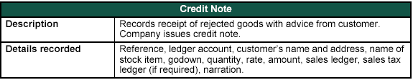
Understanding Inventory Vouchers (Contd.)
The following figure shows a credit note when a company receives rejected goods from a customer.

Slide 32
Understanding Inventory Vouchers (Contd.)
Tally.ERP 9 allows the entries of purchase, sales, debit and credit note vouchers in voucher mode as well as in invoice mode. Let us see how to enter them in voucher mode.
Notes:
You need to perform the steps given under the following topic:
5.2.13 Entering Inventory Details in Accounting Vouchers (page 120)

Slide 33
Summary
In this session, you learned that:
  Inventory vouchers perform the same function in the inventory system as accounting vouchers in Tally.ERP 9.

